Slide 1
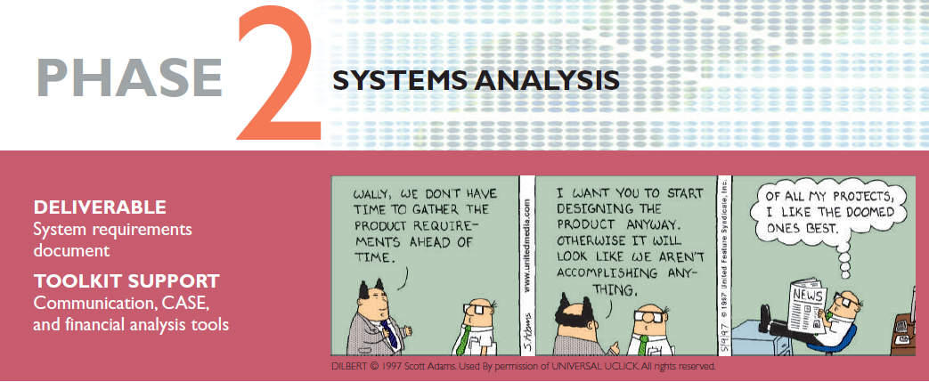
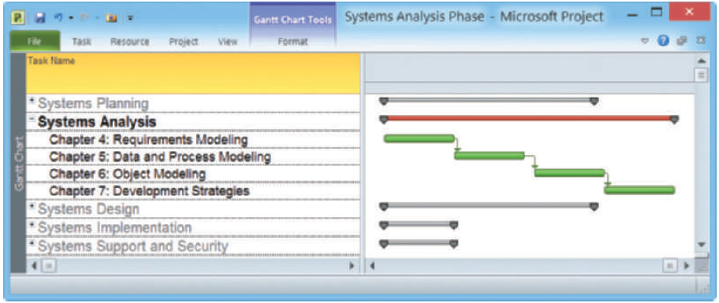


Systems Analysis and Design, 11th Edition
Scott Tilley and Harry Rosenblatt

Slide 2
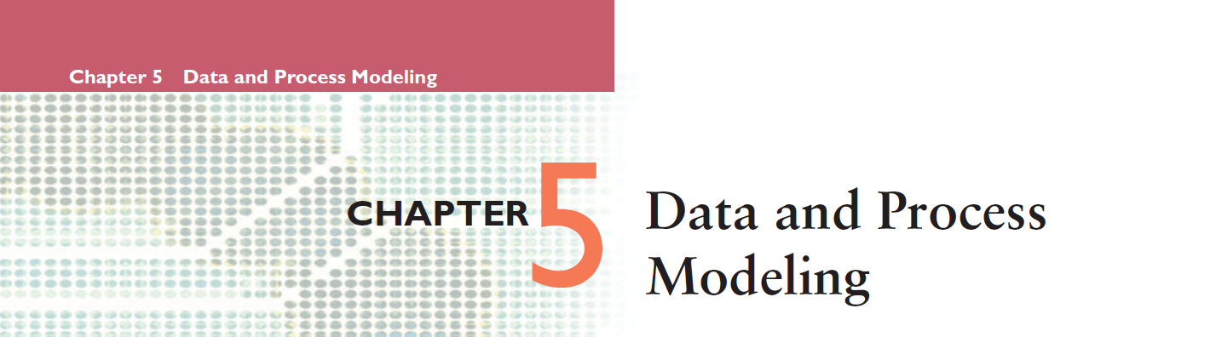
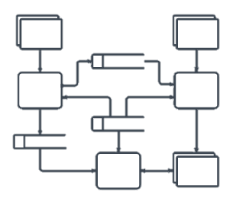
This chapter discusses data and process modeling techniques that analysts use to show how the system transforms data into useful information.
The deliverable, or end product, of data and process modeling is a logical model that will support business operations and meet user needs.

Slide 3
Chapter Objectives
Describe data and process modeling concepts and tools, including data flow diagrams, a data dictionary, and process descriptions
Describe the symbols used in data flow diagrams and explain the rules for their use
Draw data flow diagrams in a sequence, from general to specific
Explain how to level and balance a set of data flow diagrams

Slide 4
Chapter Objectives
Describe how a data dictionary is used and what it contains
Use process description tools, including structured English, decision tables, and decision trees
Describe the relationship between logical and physical models

Slide 5
Introduction
In chapter 5, you use data and process modeling techniques to develop a logical model of the proposed system and document the system requirements
  Logical model shows what the system must do
  Physical model describes how the system will be constructed

Slide 6
Overview of Data and Process Modeling Tools
Systems analysts (SA) use many graphical techniques to describe an information system
A Data Flow Diagram (DFD) uses various symbols to show how the system transforms input data into useful information

Slide 7

Data Flow Diagrams
A Data Flow Diagram (DFD) shows how data moves through an information system but does not show program logic or processing steps
A set of DFDs provides a logical model that shows what the system does, not how it does it
https://www.lucidchart.com/pages/data-flow-diagram

Slide 8
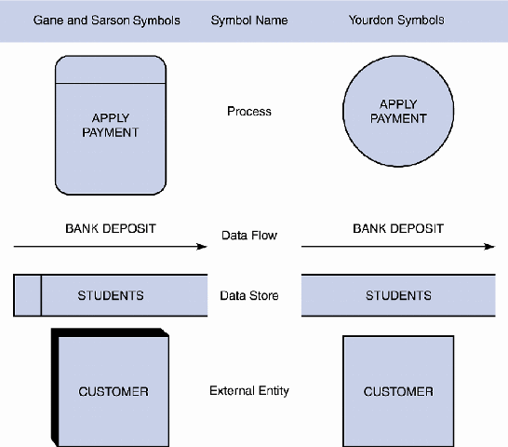
Data Flow Diagrams
DFD Symbols
  DFDs use four basic symbols that represent processes, data flows, data stores, and entities
    Gane and Sarson symbol set
    Yourdon symbol set

Slide 9
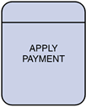
Data Flow Diagrams
DFD Symbols
  1. Process symbol
    Receives input data and produces output that has a different content, form, or both
    Contain the business logic, also called business rules
    Referred to as a black box
does not show program logic or processing steps

Slide 10
Data Flow Diagrams
DFD Symbols
  Rules for Processes
    Processes cannot consume or create data
      Must have at least 1 input data flow (to avoid miracles)
      Must have at least 1 output data flow (to avoid black holes)
      Should have sufficient inputs to create outputs (to avoid gray holes)

Slide 11
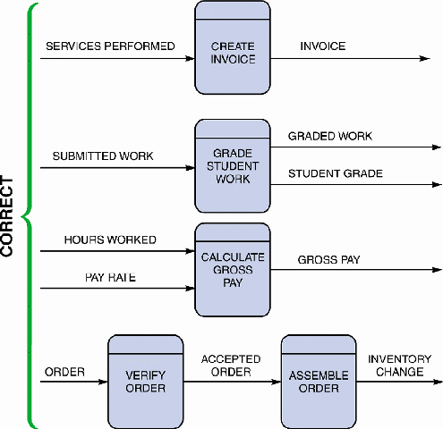
Data Flow Diagrams
DFD Symbols
  2. Data flow symbol
    Represents one or more data items
    The symbol for a data flow is a line with a single or double arrowhead

Slide 12
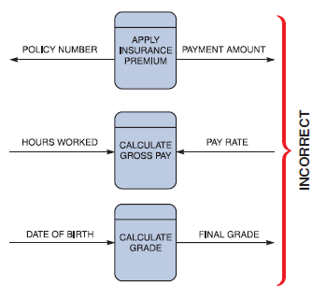
Data Flow Diagrams
DFD Symbols
  2. Data flow symbol
    three data flow and process combinations that must be avoided:
    Spontaneous generation. produces output, but has no input data flow. Because it has no input, the process is called a spontaneous generation process.
    Black hole. which is a process that has input, but produces no output.
    Gray hole. A gray hole is a process that has at least one input and one output, but the input obviously is insufficient to generate the output shown
Insufficient input to generate output

Slide 13
Data Flow Diagrams
DFD Symbols
  Rules for Data Flows
    From external entity (source) to system
    From system to external entity (sink)
    From internal symbol to internal symbol, but always either start or end at a process

Slide 14

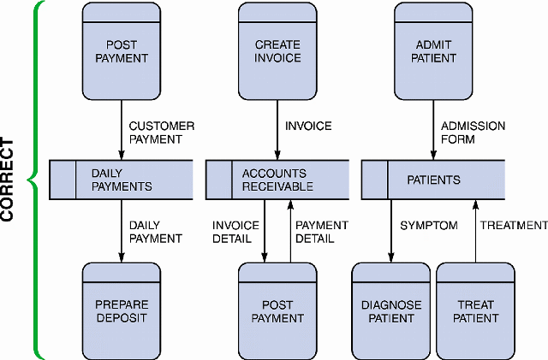
Data Flow Diagrams
DFD Symbols
  3. Data store symbol
    Represent data that the system stores
    The physical characteristics of a data store are unimportant because you are concerned only with a logical model
    Is a flat rectangle that is open on the right side and closed on the left side

Slide 15
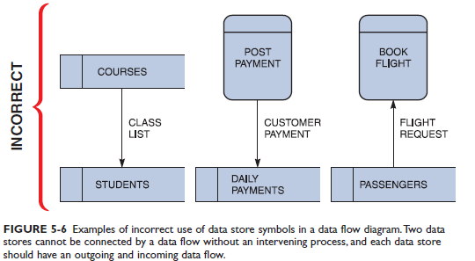
Data Flow Diagrams
DFD Symbols
  3. Data store symbol
    At least has 1 incoming & outgoing data flow

Slide 16
Data Flow Diagrams
DFD Symbols
  Rules for Data Stores
    Internal to the system
    Data at rest
    Include in system if the system processes transform the data
      Store, Add, Delete, Update
    Every data store on DFD should correspond to an entity on an ERD

Slide 17
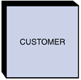
Data Flow Diagrams
DFD Symbols
  4. Entity Symbol
    Name of the entity appears inside the symbol
    shows only external entities that provide data to the system or receive output from the system.
    DFD entities are also called:
      Terminators: data origins or final destinations.
      Source: entity that supplies data to the system
      Sink: entity that receives data from the system

Slide 18
Data Flow Diagrams
DFD Symbols
  Rules for Entity
    External people, systems and data stores
    Reside outside the system, but interact with system
    Either
      a) receive info from system
      b) trigger system into motion
      c) provide new information to system

Slide 19
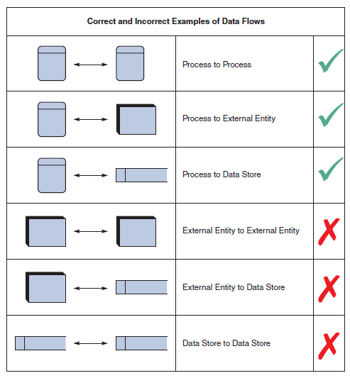
Rules for Using DFD Symbols
YES
NO

Slide 20
Creating a Set of DFDs
Create a graphical model of the information system based on your fact-finding results
Three-step process
  Step 1: Draw a context diagram
  Step 2: Draw a diagram 0 DFD
  Step 3: Draw the lower-level diagrams

Slide 21
Creating a Set of DFDs
Guidelines for Drawing DFDs
  Draw the context diagram so that it fits on one page
  Use the name of the information system as the process name in the context diagram
  Use unique names within each set of symbols
  Do not cross lines
  Provide a unique name and reference number for each process
  Obtain as much user input and feedback as possible

Slide 22
Creating a Set of DFDs
Step 1: Draw a Context Diagram
A context diagram is a top-level view of an information system that shows the system’s boundaries and scope.
Provides the most general view of an information system and contains a single process symbol, which is like a black box.
To draw a context diagram, start by placing a single process symbol in the centre of the page.
The symbol represents the entire information system, and it is identified as process 0.
Data stores are not shown in the context diagram because they are contained within the system and remain hidden until more detailed diagrams are created.

Slide 23
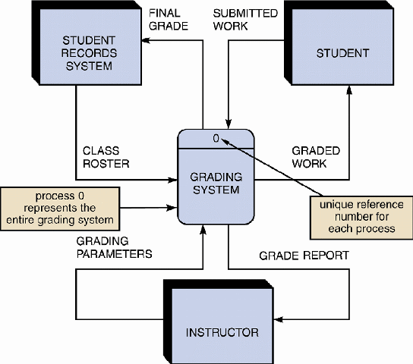
Creating a Set of DFDs
Step 1: Draw a Context Diagram

Slide 24
Creating a Set of DFDs
Step 2: Draw a Diagram 0 DFD
To show the detail inside the black box, a DFD diagram 0 is created.
Diagram 0 provides an overview of all the components that interact to form the overall system.
  It zooms in on the system and shows major internal processes, data flows, and data stores. (Diagram 0 is an exploded view of process 0)
Diagram 0 also repeats the entities and data flows that appear in the context diagram. = all the connections that flow into and out of process 0 must be retained.
  Parent diagram : the higher-level diagram
  Child diagram : the lower-level diagram
Functional primitive : is a process that consists of a single function that is not exploded further.

Slide 25
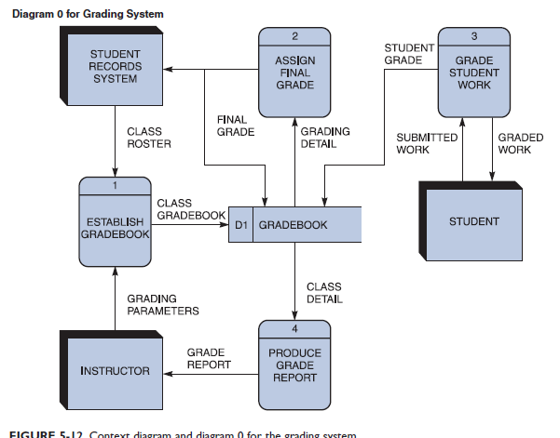
Creating a Set of DFDs
Step 2: Draw a Diagram 0 DFD

Slide 26
Creating a Set of DFDs
Step 3: Draw the Lower-Level Diagrams
  Must use leveling and balancing techniques
  Leveling is the process of drawing a series of increasingly detailed diagrams, until all functional primitives are identified.
  Balancing maintains consistency among a set of DFDs by ensuring that input and output data flows align properly

Slide 27
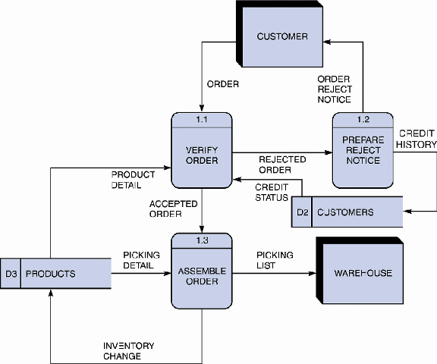
Creating a Set of DFDs
Step 3: Draw the Lower-Level Diagrams
  Leveling examples
    Uses a series of increasingly detailed DFDs to describe an information system
    Leveling is also called exploding, partitioning, or decomposing

Slide 28
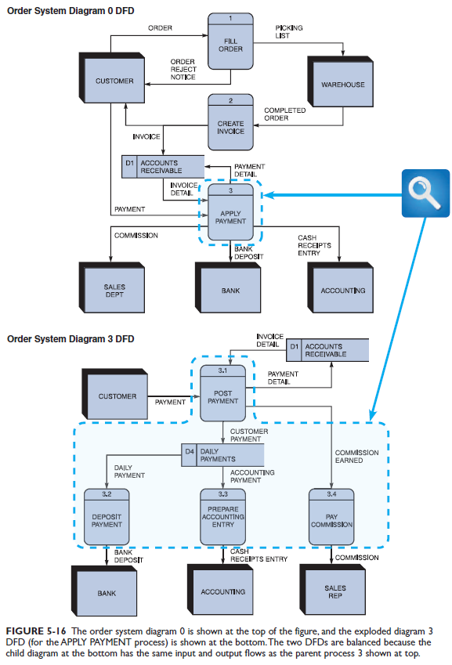
Creating a Set of DFDs
Step 3: Draw the Lower-Level Diagrams
  Balancing examples
    Ensures that the input and output data flows of the parent DFD are maintained on the child DFD
    For example, Figure 5-16 shows two DFDs: The order system diagram 0 is shown at the top of the figure, and the exploded diagram 3 DFD is shown at the bottom.

Slide 29
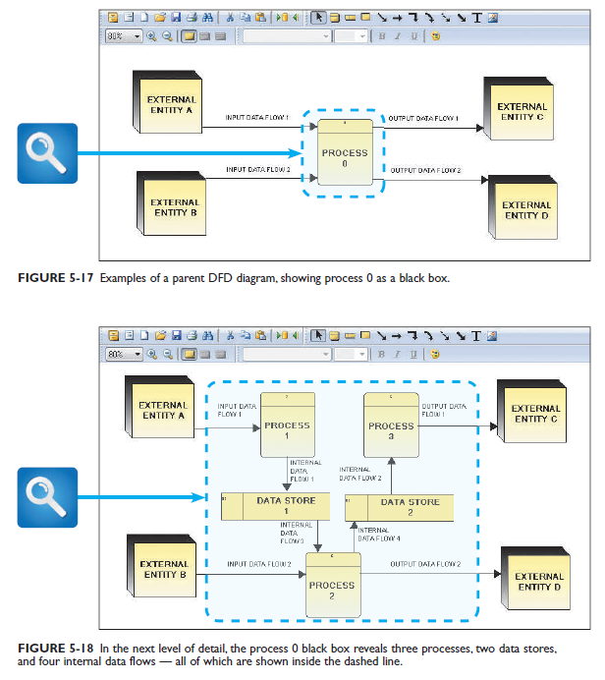

Slide 30
Data Dictionary
A data dictionary, or data repository, is a central storehouse of information about the system’s data
An analyst uses the data dictionary to collect, document, and organize specific facts about the system
Also defines and describes all data elements and meaningful combinations of data elements

Slide 31
Data Dictionary
A data element, also called a data item or field, is the smallest piece of data that has meaning
Data elements are combined into records, also called data structures
A record is a meaningful combination of related data elements that is included in a data flow or retained in a data store

Slide 32
Data Dictionary
Using CASE Tools for Documentation
  The more complex the system, the more difficult it is to maintain full and accurate documentation
  Modern CASE tools simplify the task
  A CASE repository ensures data consistency

Slide 33
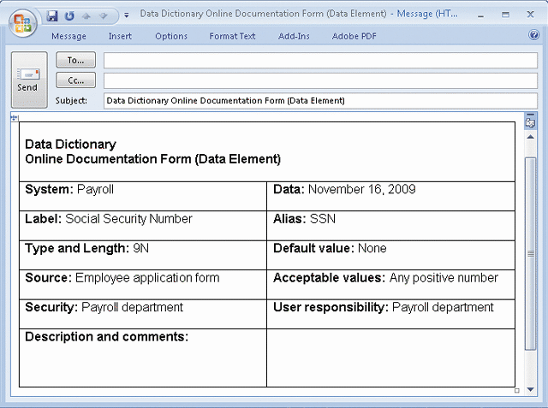
Data Dictionary
Documenting the Data Elements
  You must document every data element in the data dictionary
  The objective is the same: to provide clear, comprehensive information about the data and processes that make up the system

Slide 34
Data Dictionary
Documenting the Data Elements
  The following attributes usually are recorded and described
    Data element name and label
    Alias
    Type and length
    Default value
    Acceptable values - Domain and validity rules

Slide 35
Data Dictionary
Documenting the Data Elements
  The following attributes usually are recorded and described
    Source
    Security
    Responsible user(s)
    Description and comments

Slide 36
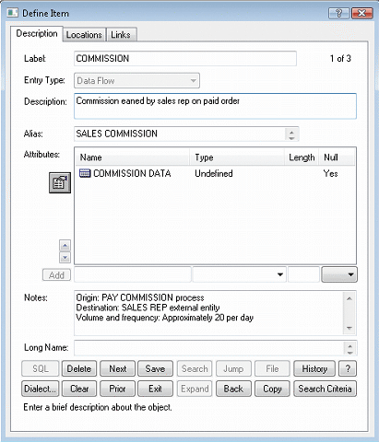
Data Dictionary
Documenting the Data Flows
  The typical attributes are as follows
    Data flow name or label
    Description
    Alternate name(s)
    Origin
    Destination
    Record
    Volume and frequency

Slide 37
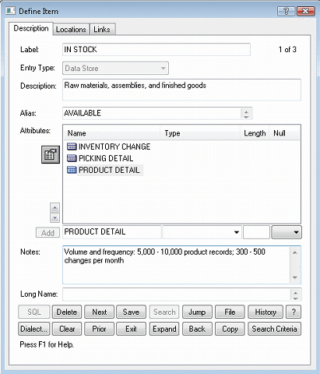
Data Dictionary
Documenting the Data Stores
  Typical characteristics of a data store are
    Data store name or label
    Description
    Alternate name(s)
    Attributes
    Volume and frequency

Slide 38
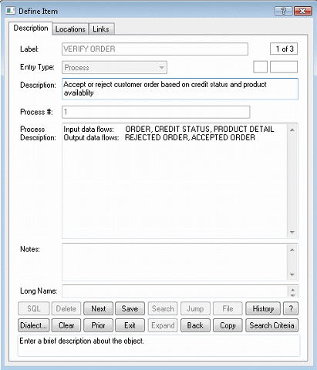
Data Dictionary
Documenting the Processes
  Typical characteristics of a process
    Process name or label
    Description
    Process number
    Process description

Slide 39
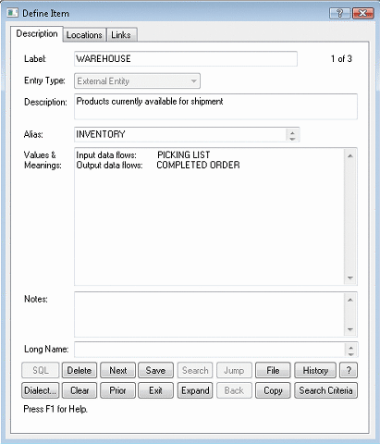
Data Dictionary
Documenting the Entities
  Typical characteristics of an entity include
    Entity name
    Description
    Alternate name(s)
    Input data flows
    Output data flows

Slide 40
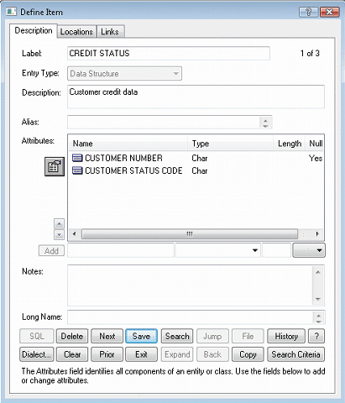
Data Dictionary
Documenting the Records
  Typical characteristics of a record include
    Record or data structure name
    Definition or description
    Alternate name(s)
    Attributes

Slide 41
Data Dictionary
Data Dictionary Reports
  Many valuable reports
    An alphabetized list of all data elements by name
    A report describing each data element and indicating the user or department that is responsible for data entry, updating, or deletion
    A report of all data flows and data stores that use a particular data element
    Detailed reports showing all characteristics of data elements, records, data flows, processes, or any other selected item stored in the data dictionary

Slide 42
Process Description Tools
A process description documents the details of a functional primitive, which represents a specific set of processing steps and business logic
It should be noted that this chapter deals with structured analysis, but the process description tools also can be used in object-oriented development, which is described in Chapter 6

Slide 43
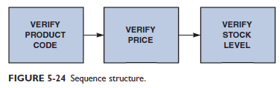
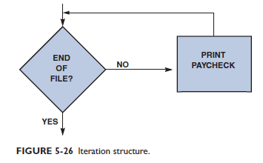
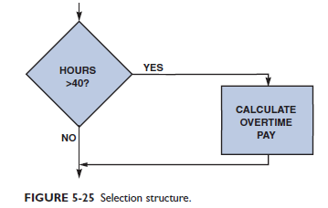
Process Description Tools
Modular Design
  Based on combinations of three logical structures, sometimes called control structures, which serve as building blocks for the process
    Sequence
    Selection
    Iteration - looping

Slide 44
Process Description Tools
Structured English
  Must conform to the following rules
    Use only the three building blocks of sequence, selection, and iteration
    Use indentation for readability
    Use a limited vocabulary, including standard terms used in the data dictionary and specific words that describe the processing rules

Slide 45
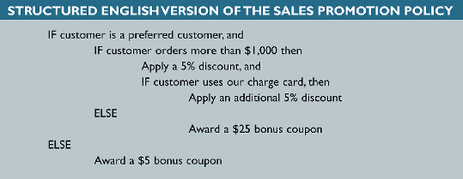
Process Description Tools
Structured English
  Might look familiar to programming students because it resembles pseudocode
  The primary purpose of structured English is to describe the underlying business logic

Slide 46
Process Description Tools
Decision Tables
  Shows a logical structure, with all possible combinations of conditions and resulting actions
  It is important to consider every possible outcome to ensure that you have overlooked nothing
  The number of rules doubles each time you add a condition
  Can have more than two possible outcomes
  Often are the best way to describe a complex set of conditions

Slide 47
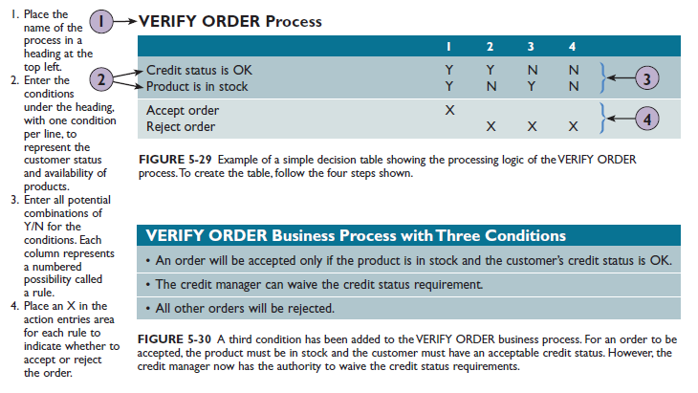
Process Description Tools
Decision Tables

Slide 48
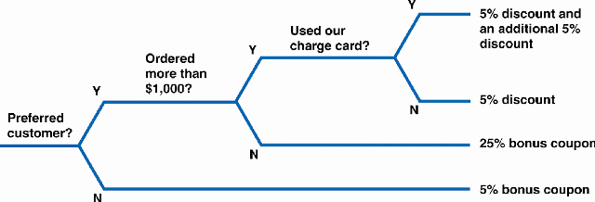
Process Description Tools
Decision Trees
  Graphical representation of the conditions, actions, and rules found in a decision table
  Whether to use a decision table or tree often is a matter of personal preference

Slide 49
Logical Versus Physical Models
While structured analysis tools are used to develop a logical model for a new information system, such tools also can be used to develop physical models of an information system
A physical model shows how the system’s requirements are implemented

Slide 50
Logical Versus Physical Models
Sequence of Models
  Many systems analysts create a physical model of the current system and then develop a logical model of the current system before tackling a logical model of the new system
  Performing that extra step allows them to understand the current system better

Slide 51
Logical Versus Physical Models
Four-Model Approach
  Develop a physical model of the current system, a logical model of the current system, a logical model of the new system, and a physical model of the new system
  The only disadvantage of the four-model approach is the added time and cost

Slide 52
Chapter Summary
During data and process modeling, a systems analyst develops graphical models to show how the system transforms data into useful information
The end product of data and process modeling is a logical model that will support business operations and meet user needs
Data and process modeling involves three main tools: data flow diagrams, a data dictionary, and process descriptions

Slide 53
Chapter Summary
Data flow diagrams (DFDs) graphically show the movement and transformation of data in the information system
DFDs use four symbols
A set of DFDs is like a pyramid with the context diagram at the top

Slide 54
Chapter Summary
The data dictionary is the central documentation tool for structured analysis
Each functional primitive process is documented using structured English, decision tables, and decision trees
Structured analysis tools can be used to develop a logical model during one systems analysis phase, and a physical model during the systems design phase
Chapter 5 complete

Slide 55
Chapter 4: Data & Process Modeling
Next Chapter…
Chapter 5: Development Strategies

